Slide 1
PROJECT "DIGITAL AND ENTREPRENEURIAL SKILLS FOR WOMEN IN RURAL AREAS"
Prof. dr Nataša Gospić, president
MSc Divna Vučković, vice president
NGO EQUAL OPPORTUNITIES
SKOPLJE 16.10.2019

Slide 2
CSO EQUAL OPPORTUNITIES
The Equal Opportunities was founded in 2002 with the aim of enabling women and men to equally access to modern information and communication technologies through the establishment of permanent mechanisms to bridge the digital and gender gap.
OBJECTIVES:
Launching initiatives to improve the implementation of ICT in everyday life and work, citizens and especially women, through trainings, discussions, research, studies, etc.
Research on gender participation in ICT use,
Participation in the establishment of training centers for trainers and trainees for the use of ICT in their daily work and life,
Development of online courses for the advancement of women and gender equality
Printing popular literature
PROJECTS - A large number of successfully completed national and international projects can be seen on
www.e-jednakost.org.rs

Slide 3
PROJECT "DIGITAL AND ENTREPRENEURIAL SKILLS FOR WOMEN IN RURAL AREAS„ -DESWRA
GOALS:
Developing entrepreneurial skills and increasing employment opportunities for women in rural areas through the development of new digital knowledge, skills and competences;
Using all the benefits of a continuous digital transformation process to support one of the most disadvantaged groups - women in rural areas in Serbia;
Facilitating equal participation of unemployed women from rural areas, as multiple discriminate persons, in the labor market;
Development of entrepreneurial activities in agricultural production, access to information related to modern trends and innovations in organic agriculture and rural tourism and related business opportunities;
Establishing a process of actively networking women with and with women from other rural areas to share ideas, experiences, knowledge and employment opportunities.

Slide 4
DONATORS
This project is supported by:
The United Nations Agency for Gender Equality and Women's Empowerment in Serbia (UN WOMEN) under the European Union-funded project “Priority Actions to Support Gender Equality in Serbia";
Coordination Body for Gender Equality and
Ministry of European Integration of the Republic of Serbia.

Slide 5
MUNICIPALITIES INCLUDED IN PROJECT
KNIĆ, 25. – 29.11.2018.
LJUBOVIJA, 05.- 9.12.2018.
MAJDANPEK, 14. – 18.12.2018.
KURŠUMLIJA, 22.01. – 26.01.2019.
PARAĆIN, 05.02. – 09.02.2019.
IVANJICA, 18.03.- 22.03.2019.
GREAT COOPERATION WITH LOCAL GOVERNMENT
MoU signed with Local communities; Local communities leaderships were actively involved and supported Project in all stages of training implementation.
The appointed contact persons had very helpful suggestions and solutions for all the practical details that needed to be addressed.
In several training sites, a computer classroom is offered free of charge.
ESTABLISHED RELATIONS WITH LOCAL GOVERNMENTS PROVIDED OUTCOMES OF PROJECT ACTIVITIES AND ENSURED PROJECT SUSTAINABILITY

Slide 6
DSWRA PROJECT
PLANNED
REALIZED
RESULT 1: Increased capacity of women in rural areas for the new digital economy, employment and self-employment
RESULT 2: Increased level of awareness of local self-government and better understanding of the positive impact of digital skills on women's personal and professional life in rural areas
RESULT 3: Networking between trained women to promote, test, and future realize new or existing business ideas
120 women FROM RURAL AREAS received certificate that they successfully completed training (20 per each municipality)
Handbook that combined both topics: Computer Basics and Digital Entrepreneurship and distributed to each training participant in hard and e-copy
6 Cooperation Protocols signed
Active participation of local government in the organization of training
All the trainees are networked with great activity on the common Facebook site
Final Conference on "WOMEN FROM RURAL AREAS - ECONOMIC POTENTIAL IN THE RISE", held in Belgrade 10.05.2019. with more then 100 participants
GREAT SUPPORT OF THE UNITED NATIONS AGENCY FOR GENDER EQUALITY IN SERBIA IN ANY MOMENT !!!

Slide 7
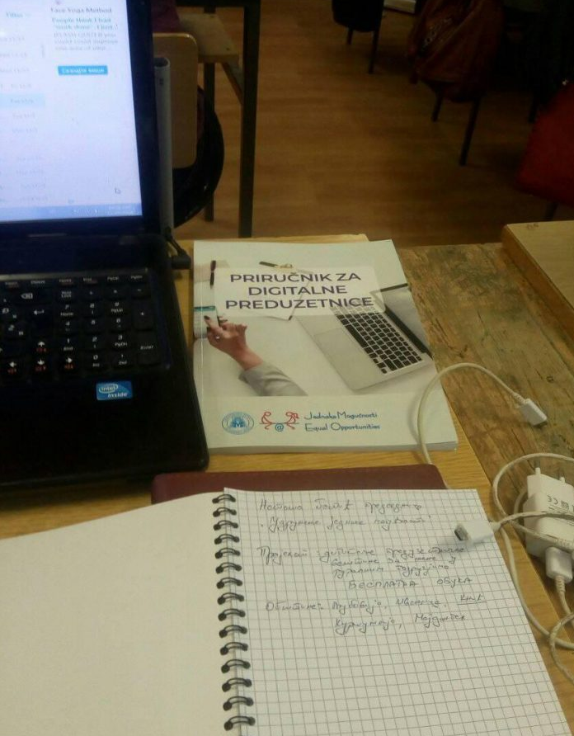
TRAINING CURRICULUM Innovative training that combines computer skills and knowledge in digital entrepreneurship in one training session
Module 1: Osnovi rada na računaru
Windows
Word
Excel
Internet
Social networks
Module 2: Fundamentals of digital entrepreneurship
Market-oriented digital entrepreneurship
A marketing approach to entrepreneurship
Marketing plan structure
Business model development
Sharing value creation
Digital communication channels

Slide 8
PROFILE OF TRAINED WOMEN
Between 20 and 64 years of age
Mostly out of work despite having gained even a high school diploma
Little or no knowledge of computer and internet use
Mostly they use FaceBook on their phones
Several pairs of mothers and daughters in training
With entrepreneurial ideas from organic food production, medicinal plants, beekeeping, confectionery, handicrafts, opening agencies and more.
Most of women were coming from rural areas
All of them were very fond of learning new skills
WOMEN HEROS

Slide 9
MEDIA COVEREGE
Contacting local media was done by both the local government and the CSO Equal opportunities
Each training was followed by local TV stations and radio reporters.
Special TV programme dedicated to the project was transmitted on TV Kragujevac .
Testimonials and stories for journalists were given by participants and representatives of the NGO Equal opportunities
Each training session is posted on Equal opportunities web site, followed by interesting stories and best practice examples
IN GENERAL LOW INTEREST OF MEDIA FOR SUCH TYPE OF EVENT!!!???

Slide 10
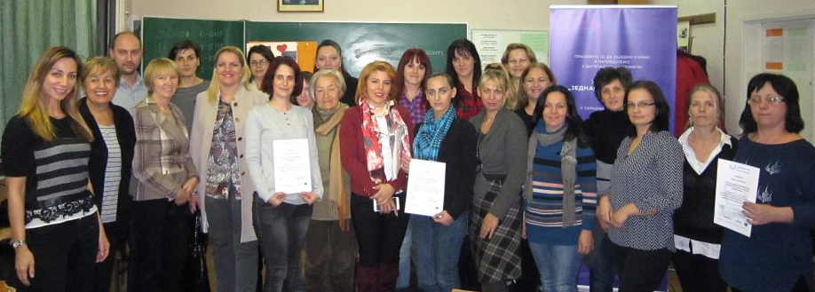
WORKING AND INSPIRATING ATMOSPHERE IN KNIĆ
Svetlana Rankovic Alempijevic, decided to start selling traditional products with a group of women from her place. "We need additional knowledge for product placement, business management or marketing. Without entrepreneurship and computers, nothing can be accomplished today, ”says Svetlana.
Neda Kostic is already working but would like to make progress. For her, this training is a chance to gain additional competencies, in order to advance and build her career.

Slide 11
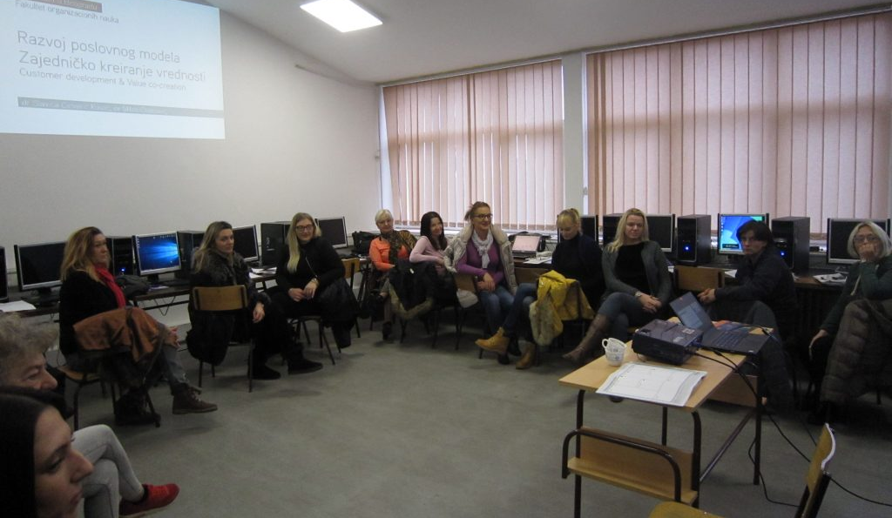
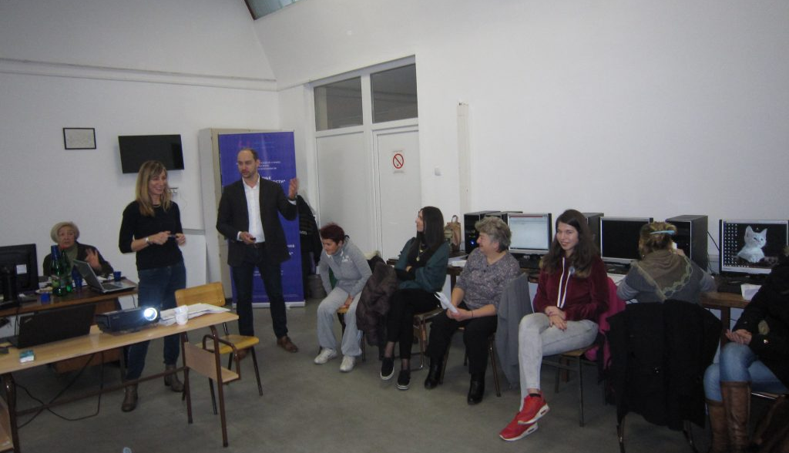
IN MUNICIPALITY LJUBOVIJA WOMEN STRENGTHENED FOR ENTREPRENEURIAL INITIATIVES
Bojana Nikolic, without a job: "... It is important for women to be free from fear, to see that they can learn everything they need, to create a business model, to make a presentation for their products, to master computer work" ...
Mira Markovic is involved in agriculture, and has never worked on a computer. She points out that she has been comfortable all along and that she has learned a lot - how to use a computer and how to better market her raspberries and blackberries and milk dairy products.

Slide 12
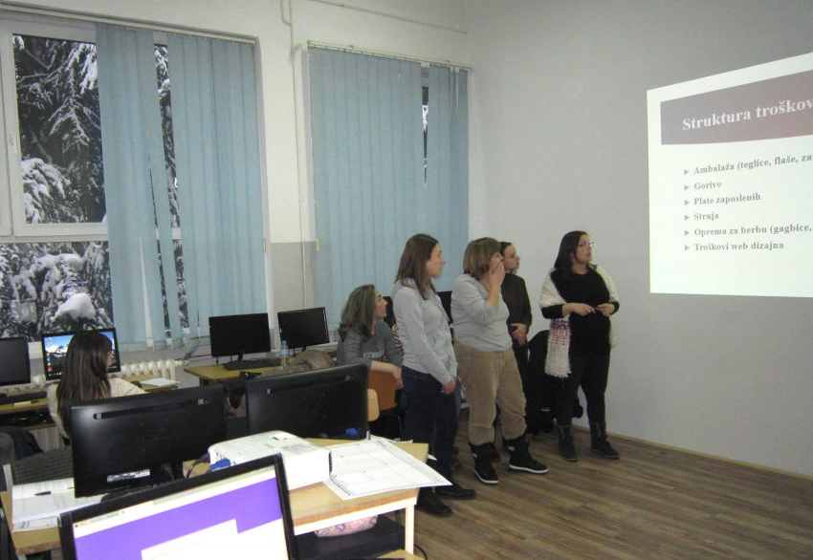
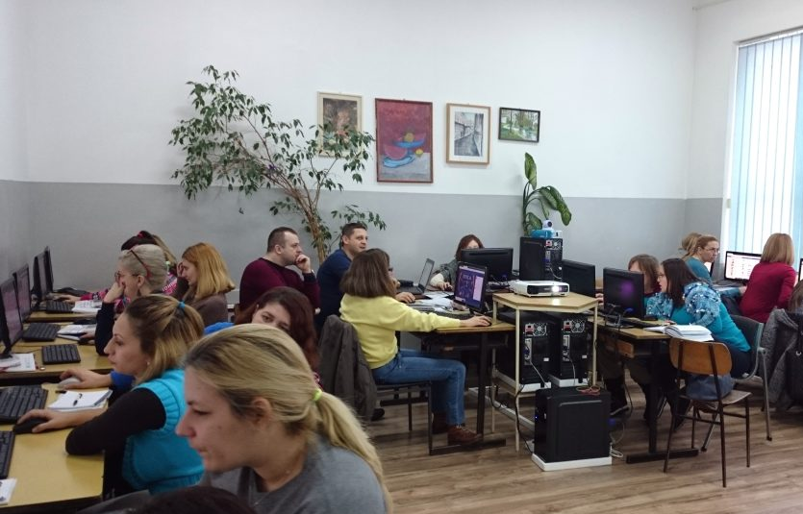
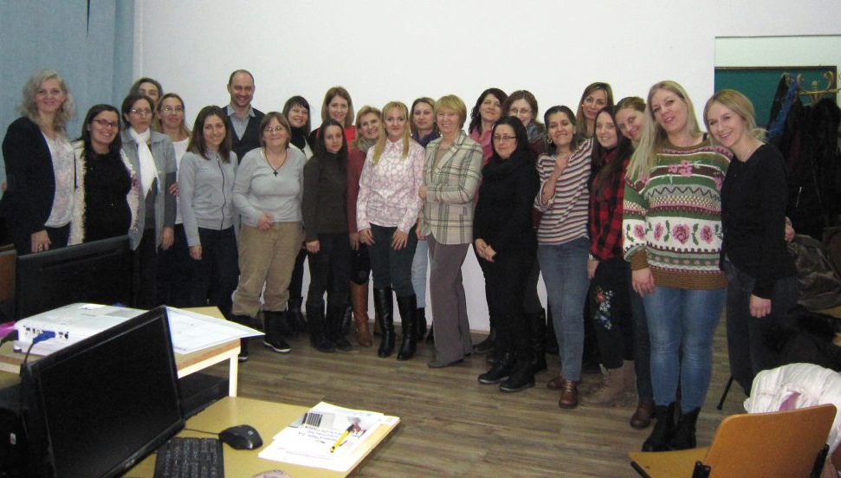
Zvezdana Telesković updated her IT skills during the training. She finds the entrepreneurial part especially interesting and useful because she had no previous knowledge. Zvezdana, in ninth month of pragnancy, came with her mother and they hope to open their own business together.
MOTHER AND DAUGHTER TOGETHER IN MUNICIPALITY MAJDANPEK TRAINING SESSION

Slide 13
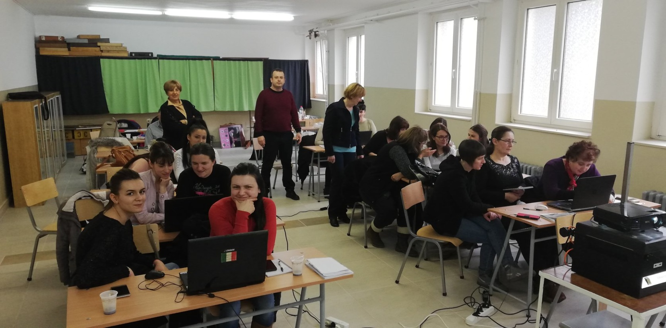
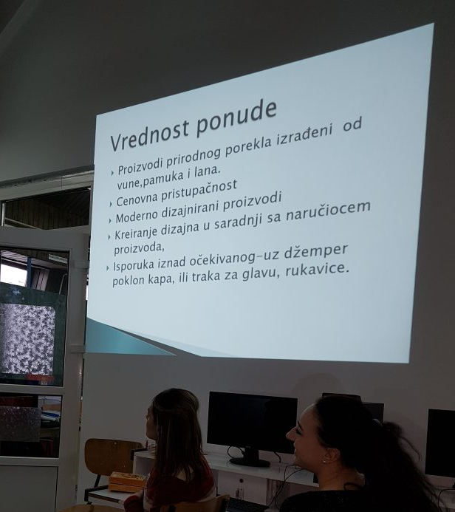
TRAINING IN MUNICIPALITY KURŠUMLIJA
Suzana Kostic, unemployed: “I think now my chances of starting a job are much higher. I have learned a lot from entrepreneurship. " She says that one of the basic qualities of these classes is that they are motivating, which encourage women to think about entrepreneurship.
Svetlana Todorovic lost her job two years ago. She was already trying to sell traditional local produce, but realized that she lacked much appropriate knowledge. "Now I'm really pleased. I learned exactly what I needed to be able to make a living by selling my products, ”says Svetlana.

Slide 14
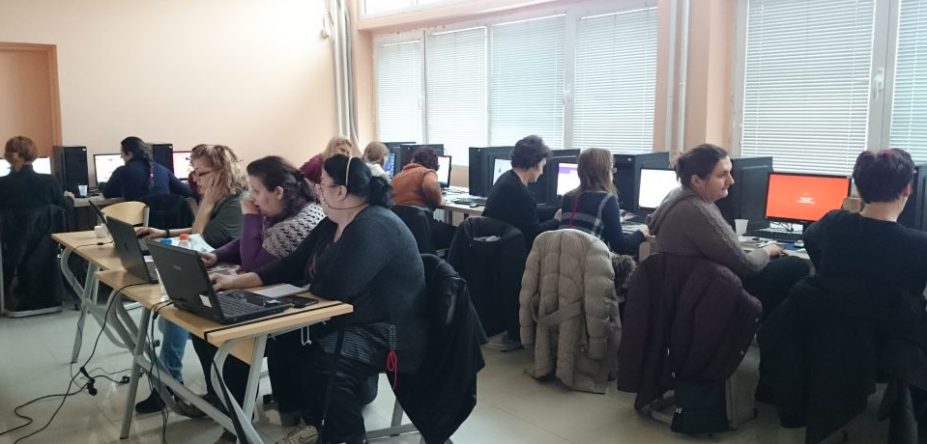
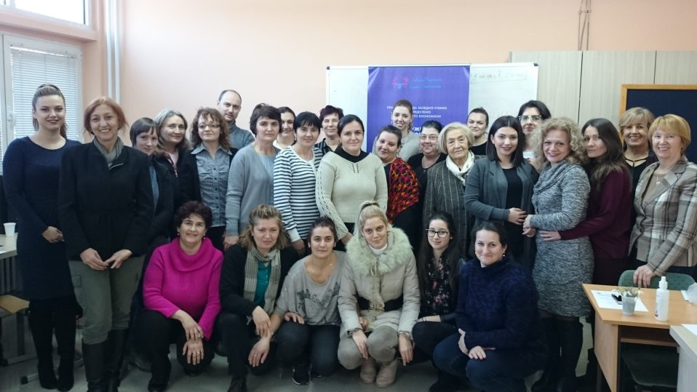
TRAINING IN MUNICIPALITY PARAĆIN
Ljubinka Antic, 64, attends classes with her daughter. He is engaged in beekeeping and plans to make an activity that will support the whole family from the cultivation of bees and the collection of honey, as well as from the sale of local products. She needed the digital and entrepreneurial skills to achieve the desired results.
Svetlana Tomic, plans to open a nursing home. She has lacked entrepreneurial knowledge and considers this training a fair chance.

Slide 15
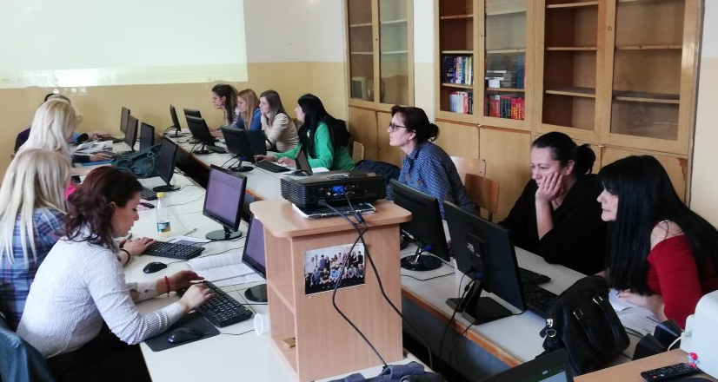
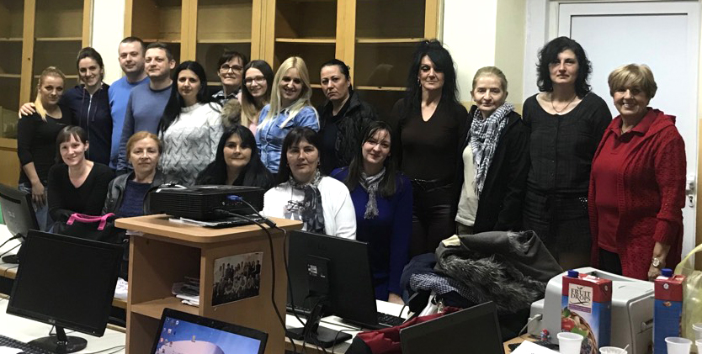
TRAINING IN MUNICIPALITY IVANJICA
"This is exactly what I needed," commented Marina Ocokoljić, who started the production of handmade pasta eight months ago. Although she has an excellent product, which she has presented at the ethno food fairs and the event "Kitchen of the World" five times already, Marina felt that she lacked knowledge in entrepreneurship and computer science for further development and advancement in business.
Zorica Gvozdenovic, since last year, has a shop selling her own handcrafted handicraft. Zorica is 59 years old and says she has worked without the internet so far, but that she has realized that only with the help of computers and new technologies can she sell her products better. "Now I will be able to take pictures of everything I make and promote it. Today I just learned how I will be able to join some groups online. "

Slide 16
CONFERENCE "WOMEN IN RURAL AREAS - ECONOMIC POTENTIAL IN RISE"
The conference was aiming, with the participation of representatives of policy makers from republic and local authorities, experts and decision-makers from local communities, the private sector and CSOs concerned with the advancement of women, to launch initiatives and disseminate information on the results of women's empowerment in rural areas in the era of digitalization and the information society
MORE THAN 100 PARTICIPANTS
RECOMMENDATIONS
For public policies, gender equality strategies and rural development strategies
Local government
CSOs
International organization
Media

Slide 17
GUIDELINES FOR WOMEN’S DIGITAL ENTREPRENEURSHIPS
RECOMMENDATIONS
GUIDELINES FOR DEVELOPMENT OF LOCAL STARTUP ECOSYSTEMS AND WOMEN’S ENTREPRENEURSHIP
INTRODUCTION
ENTREPRENEURSHIP AND/OR START UP ECOSYSTEM
FACTORS FOR DEVELOPMENT OF START UP ECOSYSTEM
GUIDELINES FOR DEVELOPMENT OF LOCAL START UP ECOSYSTEM

Slide 18
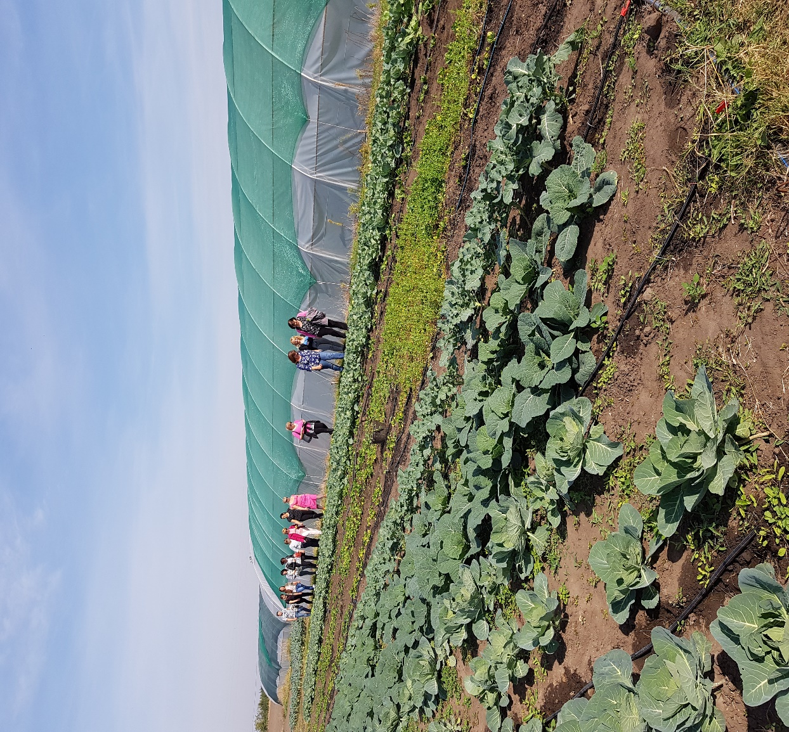
PROJECT COST EXTANSION
ACTIVITIES FOR 4 MONTHS MORE
ACTIVITIES INCLUDED:
Interactive creative workshop for 18 women who were trained in digital entrepreneurship (three women from each municipality) on DIGITAL ENTREPREUNERSHIP IN ORGANIC FOOD PRODUCTION
Study tour for participants to organic farm established by woman digital entrepreneur and
Participatory workshop between project beneficiaries and representatives of six Local Self Governments and contact persons who were involved in organization of all activities under the project, to ensure implementation of DESWRA recommendations related to local government

Slide 19
THANK YOU FOR YOUR ATTENTION!!! THANKS A LOT TO UNWOMEN GIVING A PROMINENCE TO WOMEN FROM RURAL AREAS
Q/A
www.e-jednakost.org.rs

